Slide 1
Color Homography Color Correction
CV Project
K.Sriya Deepika (20161186)
D.Sai Shritishma Reddy (20161165)
R.Karthika (20161169)

Slide 2
Introduction
In geometry computer vision, an homography relates two planes.In color, an homography relates two photometric views.
In this method, they proposed that to map one photometric view to another we must map the colors correctly independent of shading.
Since shading only affects the brightness, or magnitude, of the RGB vectors, it is possible to find the 3×3 map which maps the color rays (the RGBs with arbitrary scalings) in one photometric view to corresponding rays in another.

Slide 3
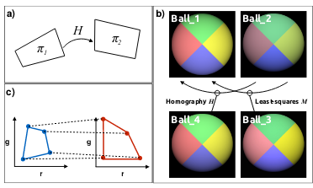
Explanation of the above figure:
We aspire to transfer color of Ball_1 to Ball_2. (Fig. b)
Fig. c shows chromaticity diagrams of Ball_1 and Ball_2 being related by a Homography.
Fig. a shows image planes being related by a chromaticity diagram.

Slide 4
Overview
Introduction to Color Homography.
Implementation of three algorithms for calculating Color Homography Color Correction. They are:
Least Square Color Correction
Alternating Least Squares Color Correction
RANSAC Color Correction
Evaluation of the above Color Correction Algorithms using the following color spaces:
CIE L*a*b color space
CIE L*u*v color space
RGB color space
Conclusion based on the above results as to which method is Algorithm gives more robust results.

Slide 5
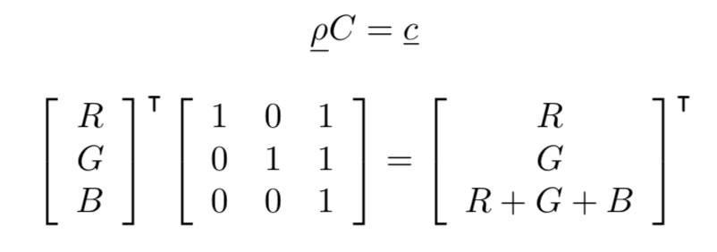
Color Homography
RGB ρ to a corresponding RGI (red-green- intensity) c using a 3 × 3 matrix C
In geometry, homographies are applied for mapping spatial coordinates in one image to correspondences in another.
We find the 3x3 matrix that best maps the shading dependent RGBs in the image of a color target and map them to the corresponding XYZs in a way that is independent of the shading.
In color, we apply homography to shading independent color correction, the homography that maps 3D colors to 3D color matches.

Slide 6

Color Homography Theorem
Theorem 1 (Color Homography):
Chromaticities across a change in capture condition (light color, shading and imaging device) are a homography apart.
Proof:
First we assume that across a change in illumination or a change in device where the shading is the same the corresponding RGB’s are related by a linear transform M
Clearly,
Due to different shading, the RGI triple under a second light is represented as c′ = α′ cH , where α′ denotes the unknown scaling.
Without loss of generality let us interpret c as a homogeneous coordinate i.e. assume its third component is 1.
Then, [r′ g′] = H([r g]) (chromaticity coordinates are a homography H() apart).
maps colors in RGI form between illuminants.

Slide 7
Least Square Color Correction
A is the input image matrix
B is the reference image matrix
A and B are reshaped to have the dimensions: [ 3, No. Of pixels in the image]
AM=B
We find M by using least squares method

Slide 8
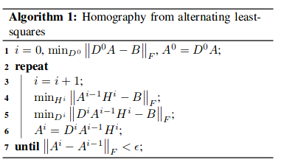
Alternating Least-Squares Color Correction
Terminology
H- Homography Matrix (Captures Color Correction Component)
D- Shading Matrix (Captures Shading Correction Component)
N - Number of pixels in the image
A - nx3 matrix of RGB’s
B - nx3 matrix of corresponding XYZ’s.
D - nxn diagonal matrix of shading factors
H - 3x3 color correction matrix
Finally B can be computed as follows
With shading correction : from the equation DAH ≈ B
Without shading correction : DA ≈ B

Slide 9
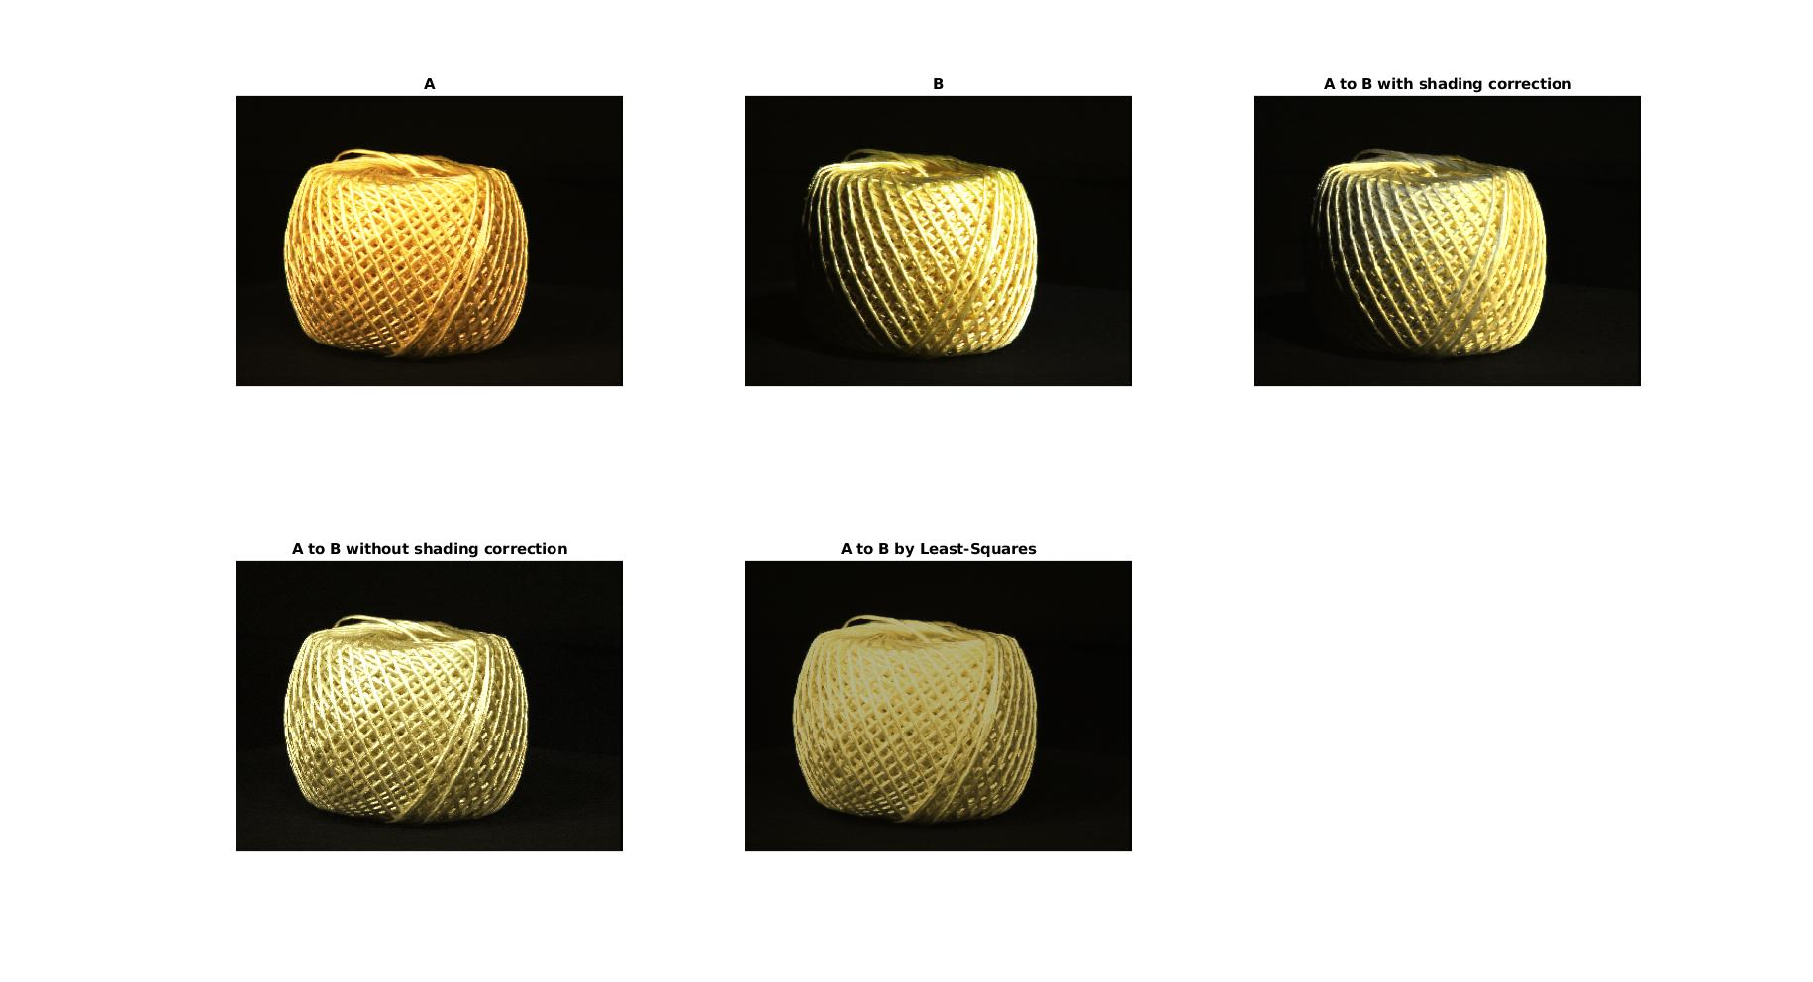
Results of ALS and LS methods
A- input image
B- reference image
The other three images are
(1) A to B with shading correction
(2) A to B without shading correction
(3) A to B by least squares

Slide 10
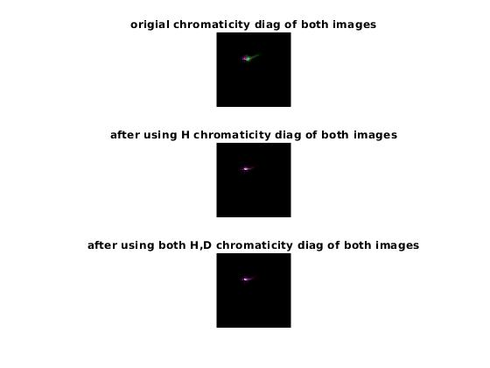
(1) Chromaticity diagram before applying homography. Purple -image B green-image A.
(2) Chromaticity diagram after applying just homography
(3) Chromaticity diagram after applying both homography and shading correction

Slide 11
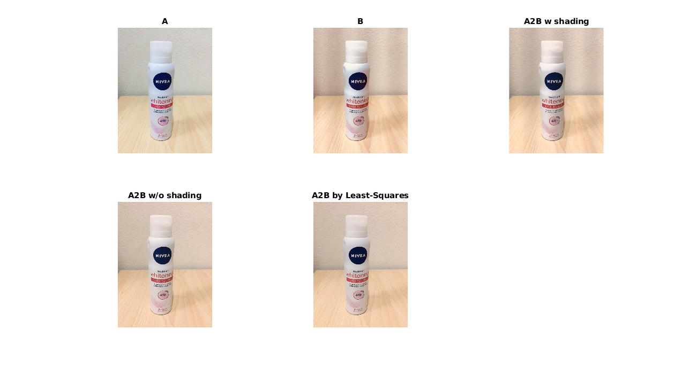
A- input image
B- reference image
The other three images are
(1) A to B with shading correction
(2) A to B without shading correction
(3) A to B by least squares

Slide 12
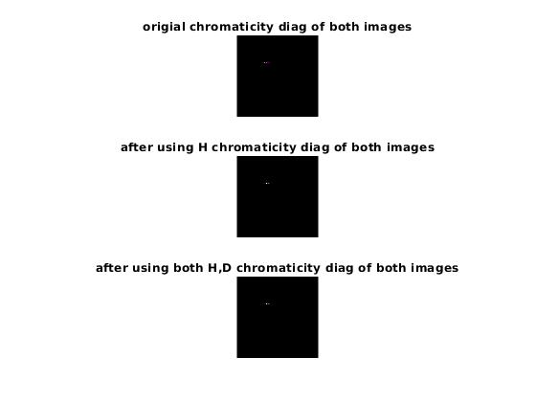
(1) Chromaticity diagram before applying homography. Purple -image B green-image A.
(2) Chromaticity diagram after applying just homography
(3) Chromaticity diagram after applying both homography and shading correction

Slide 13
RANSAC Color Correction
Chromaticity Diagrams:
They can be defined to have a size Nbin*Nbin
Steps to compute Chromaticity Diagram of an image A:
Resize A to have dimensions [3,Number of pixels]. Let this matrix be A’
Convert RGB space to RGI space by multiplying A’ with C. Let B=CA’
C=[1 0 1;0 1 1;0 0 1]
Homogenise B by dividing R, G with I space.
Construct a 1-d histograms for R and G space independently such that bin size of this histogram is 1/Nbin. Let these histograms be histR and histG.
Now construct a 2-D matrix Chrodist of dimensions Nbin*Nbin such that Chrodist[i,j]=Number of pixels falling in the ith bin of histR and jth bin of histG.

Slide 14
RANSAC Color Correction
Pseudo Code:
Input Image A to which color of Input Image B has to be transferred to form Image C
Construct Chromaticity diagrams of Image A and Image B as explained above.
Detect ASIFT features in chromaticity diagrams of Image A and B and find best matches. Smoothen Chromaticity diagrams of A and B to get required number of matches.
H matrix contains 9 variables (8 independent). Each match point gives 2 equations. Hence 4 match points are sufficient to find the Homography matrix.
We randomly choose 4 points out of the matched feature set.
We require at-least 3 points out of the 4 randomly chosen points to be non collinear to get a valid Homography matrix.This will ensure that all the 4 points are non-collinear. We check for this degeneracy of the set of 4 points using all possible combinations of 3 points from this set.
If we get a valid set we compute H using ALS algorithm.
We repeat steps 5-7 until convergence criteria is satisfied.
Convergence criteria is defined in the below two ways:
If number of trials of RANSAC are greater than 5000 (OR)
We define N = log(1-p)/log(pNoOutliers), where p=0.99 and pNoOutliers= #(outliers) / #(Total Points). We converge if N > #(trials so far)

Slide 15
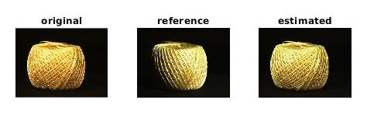
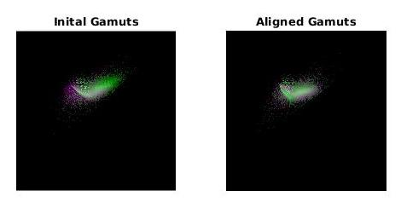
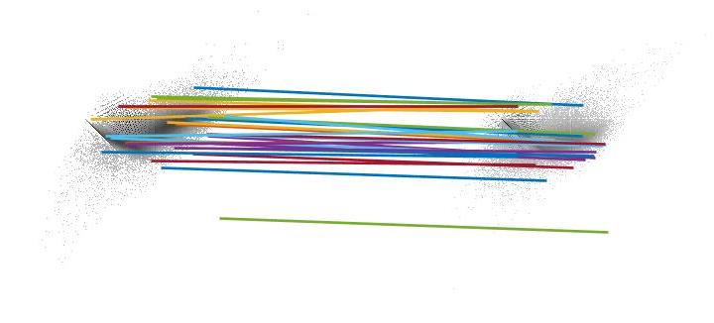
Results of RANSAC Algorithms
Matches in Chromaticity diagram using ASIFT

Slide 16
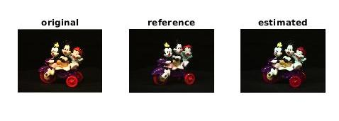
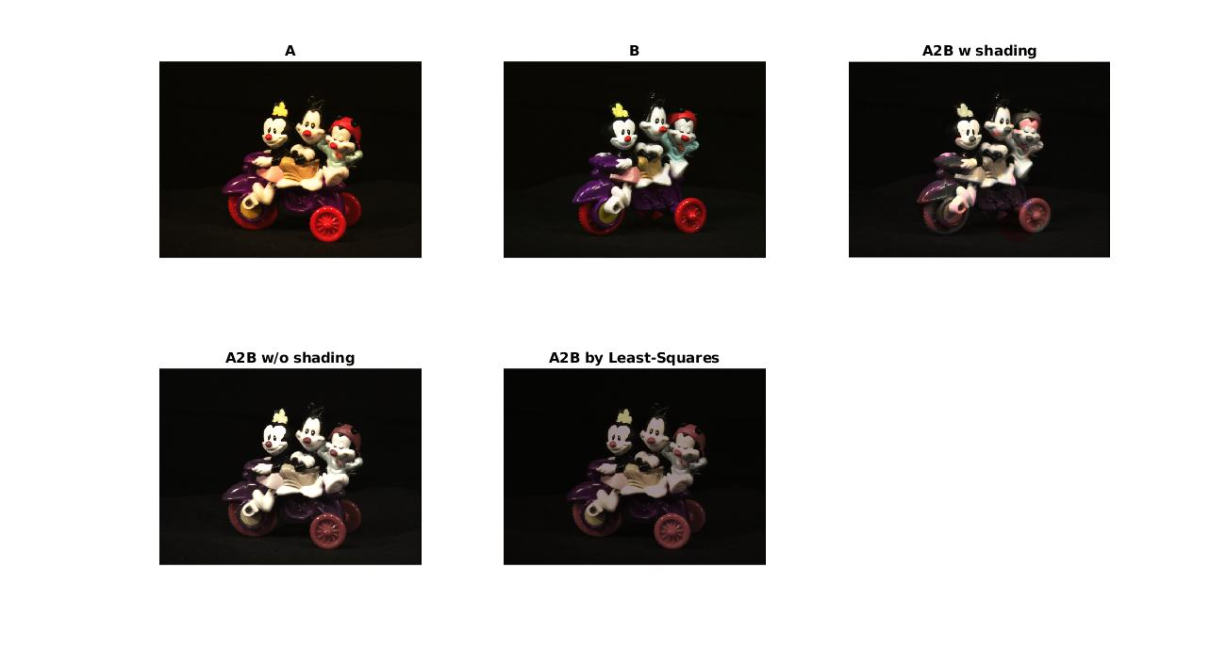
Comparing results of ALS, LS and RANSAC
RANSAC Results
ALS and LS results

Slide 17
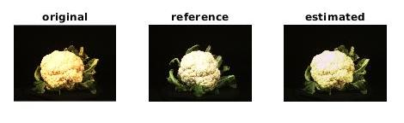
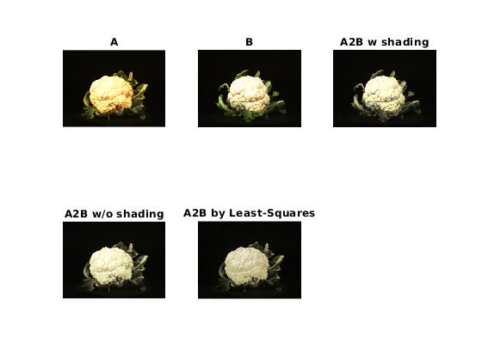
Comparing results of ALS, LS and RANSAC
RANSAC Results
ALS and LS results

Slide 18
Comparing results of ALS, LS and RANSAC
In Ransac the shading correction is not captured and the original structure of the input image is not affected whereas in ALS colour correction the shading is captured but the original structure of the input image is disturbed.

Slide 19
Evaluation Methods
We wish to evaluate color correction when shading varies across the color target (in this case a Macbeth Color Checker).
First we measure, in the lab, the actual ground truth XYZs. We call them ref_colors.
Second we, in situ, measure the RGBs in a raw image where the shading can vary across the chart.
We apply the three computed correction matrices (least-squares, ALS and RANSAC) to the RGBs form the checker where the effects of intensity variation has been removed. This color is called sv_uniform.
The intensity variation is removed by dividing by the brightness image of a uniform grey checker images in the same location in the same scene.
The colors obtained without dividing by grey values are called sv_nonuniform.

Slide 20
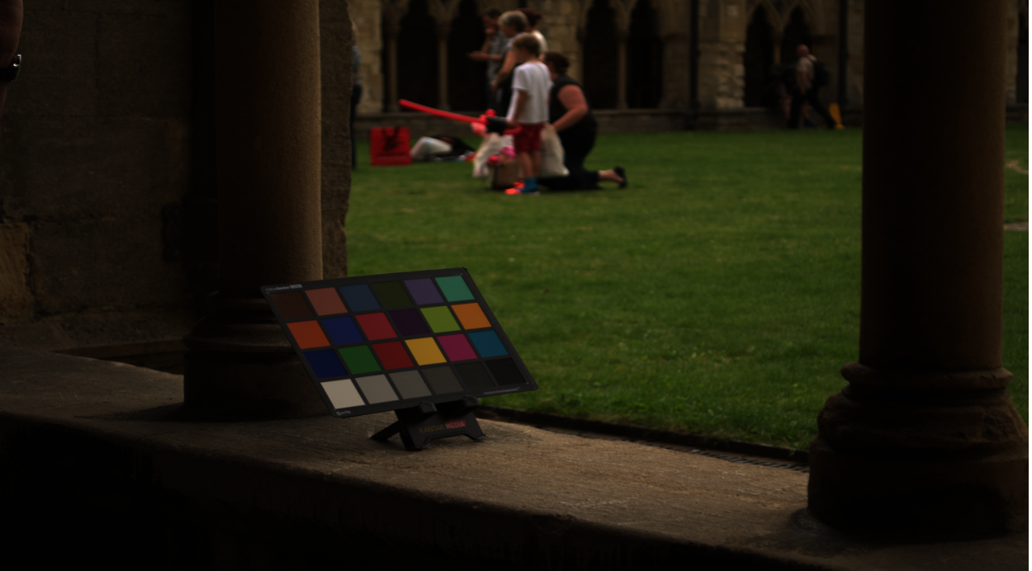
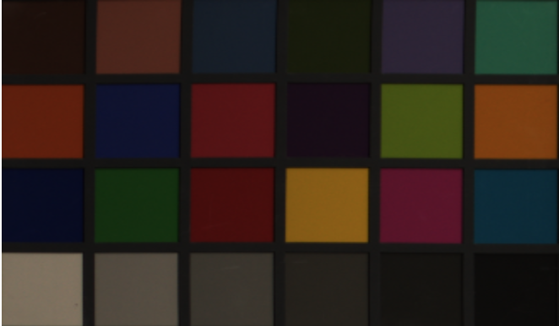
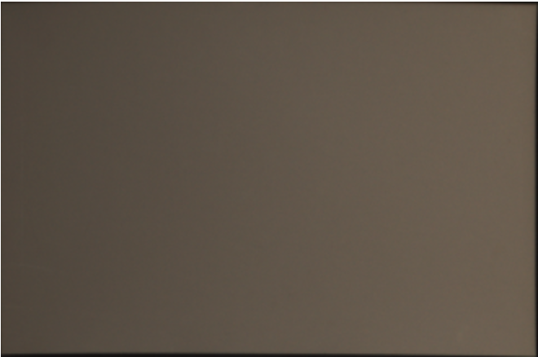
Dataset (Outdoor set up)
Uniform Grey Chart to remove intensity variation

Slide 21
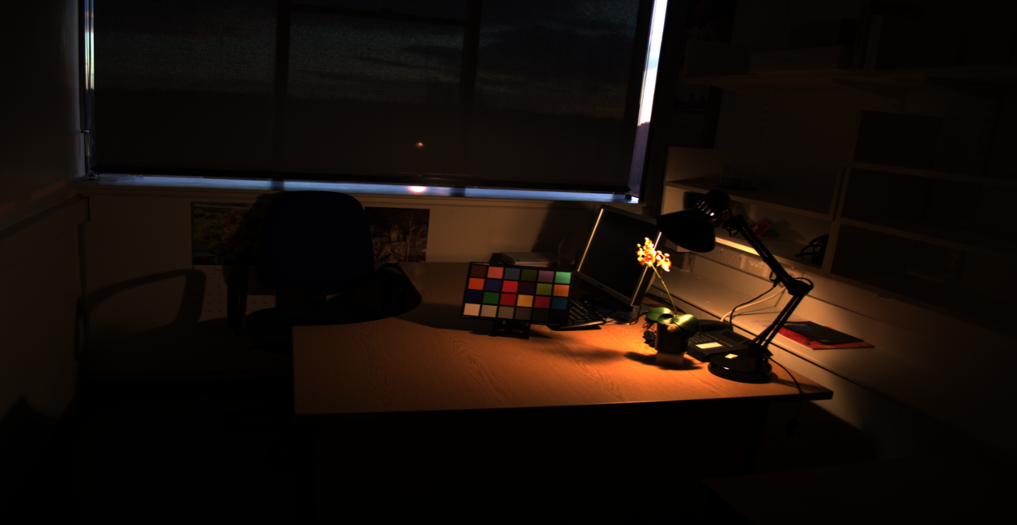
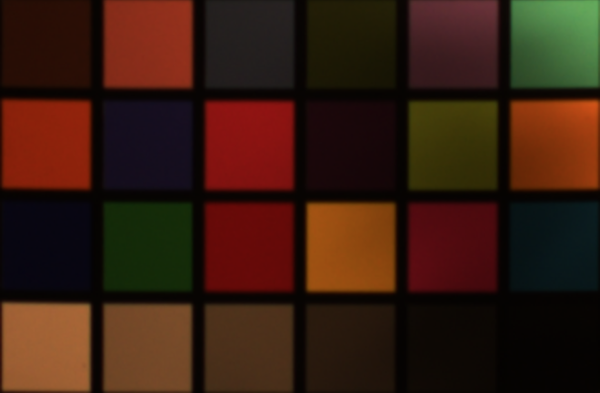
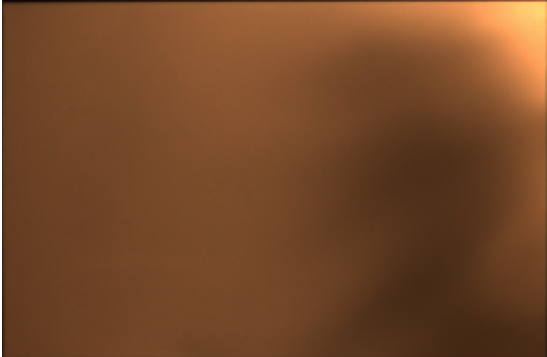
Dataset (Indoor Set up)
Uniform Grey Chart to remove intensity variation

Slide 22
Evaluation Procedure
We compute two kinds of homography matrices H_uniform and H_nonuniform by mapping ref_colors with sv_uniform and sv_nonuniform respectively, using least-squares, ALS ,RANSAC and Root Polynomial algorithms.
We use H_uniform and H_nonuniform on sv_uniform to get reconstructed reconstrcuted_ref_uniform and reconstrcuted_ref_nonuniform.
The error between reconstrcuted_ref_uniform and ref_uniform in RGB, CIE L*a*b* and CIE L*u*v* color spaces gives uniform error in RGB, CIE L*a*b* and CIE L*u*v* spaces.
The error between reconstrcuted_ref_nonuniform and ref_nonuniform in RGB, CIE L*a*b* and CIE L*u*v* color spaces gives non uniform error in RGB, CIE L*a*b* and CIE L*u*v* spaces.
We even compared our results with another method called Root polynomial which is not mentioned in the paper .

Slide 23
Root Polynomial
We even compared our results with another method called Root polynomial which is not mentioned in the paper .
The RGB’s are mapped to a standard colour space such as XYZ - useful for colour measurement- by a mapping function e.g. the simple 3×3 linear transform. This mapping, which we will refer to as LCC (linear colour correction), has been demonstrated above.An alternative and potentially more powerful method for colour correction is root polynomial colour correction (RPCC). Here, the R,GandB values at a pixel are extended by the polynomial terms.

Slide 24
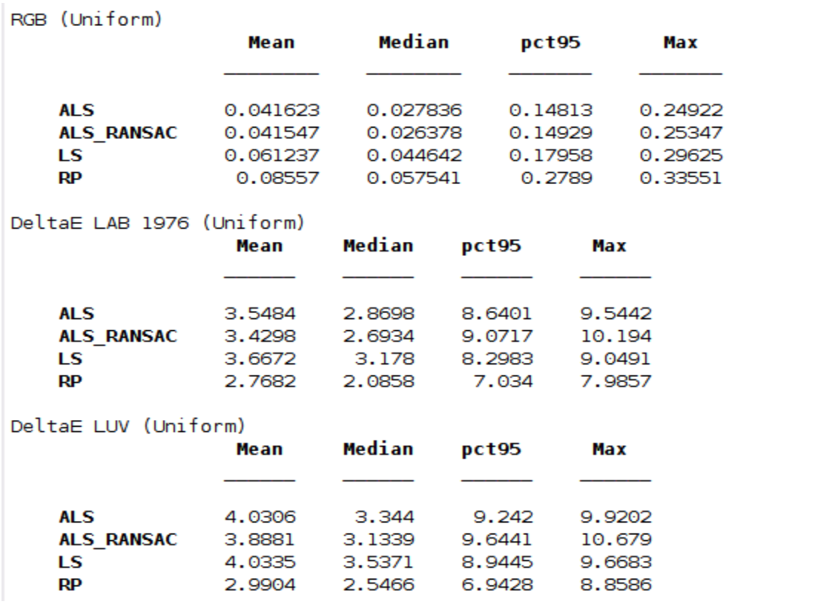
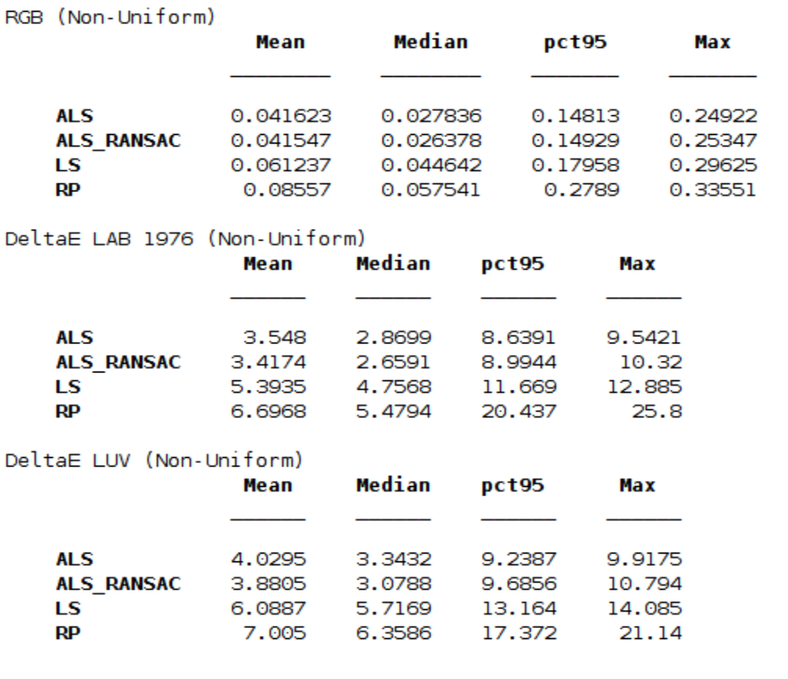
Evaluation Results

Slide 25
Analysis of Evaluation Results
The mean, median, 95% quantile and max ∆E errors are reported for RGB, CIE L*a*b* and CIE L*u*v* spaces using both uniform and non-uniform Homography matrices.
It is clear that RANSAC- homography-based color correction supports a significantly improved color correction performance compared with the simple least square (all error measures are about 40% improved).
Compared with the ALS color correction, all mean errors are improved by about 10%, and all median errors are improved by about 20%, at the cost of getting slightly higher 95% quantile error and maximum error.
Hence, RANSAC-based color homography color correction is robust to outliers and delivers improved color fidelity.

Slide 26
THANK YOU

